Slide 1
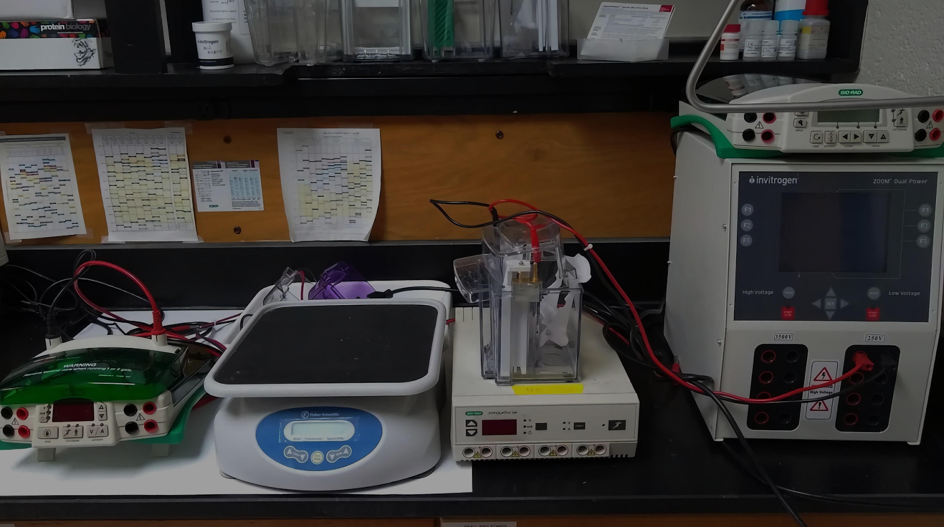
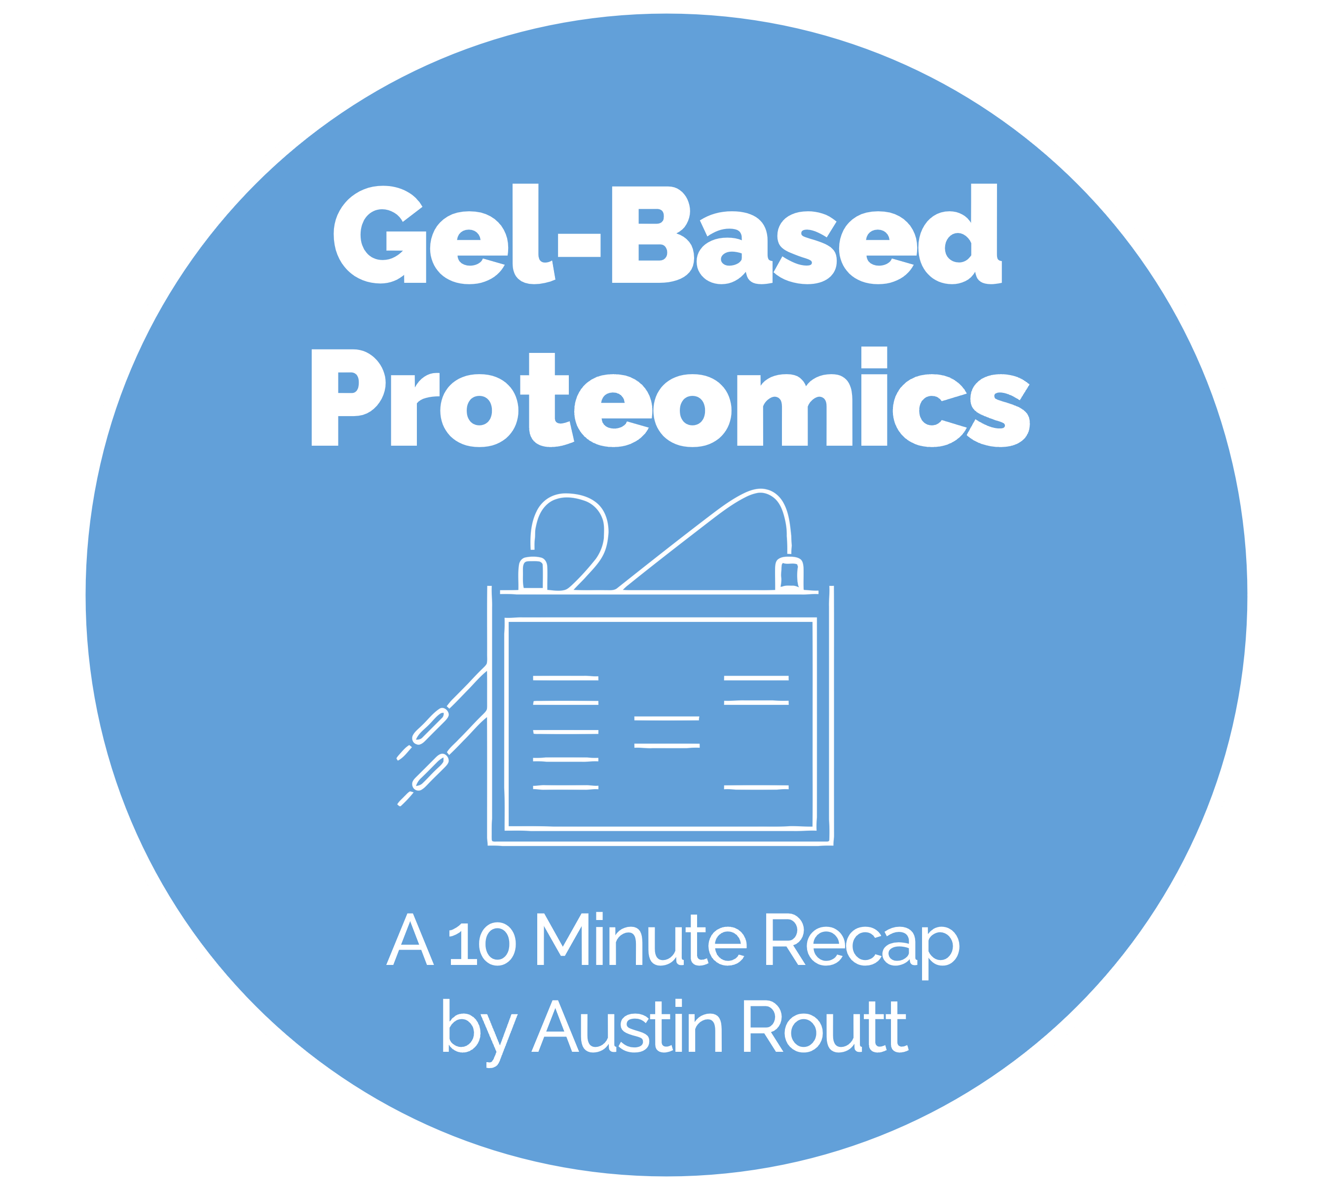
Notes:
Good afternoon, class. Thank you for coming.
I’m Austin Routt and today I’ll be presenting my 10-minute recap of Dr. Wu’s Gel-Based Proteomics lecture.

Slide 2

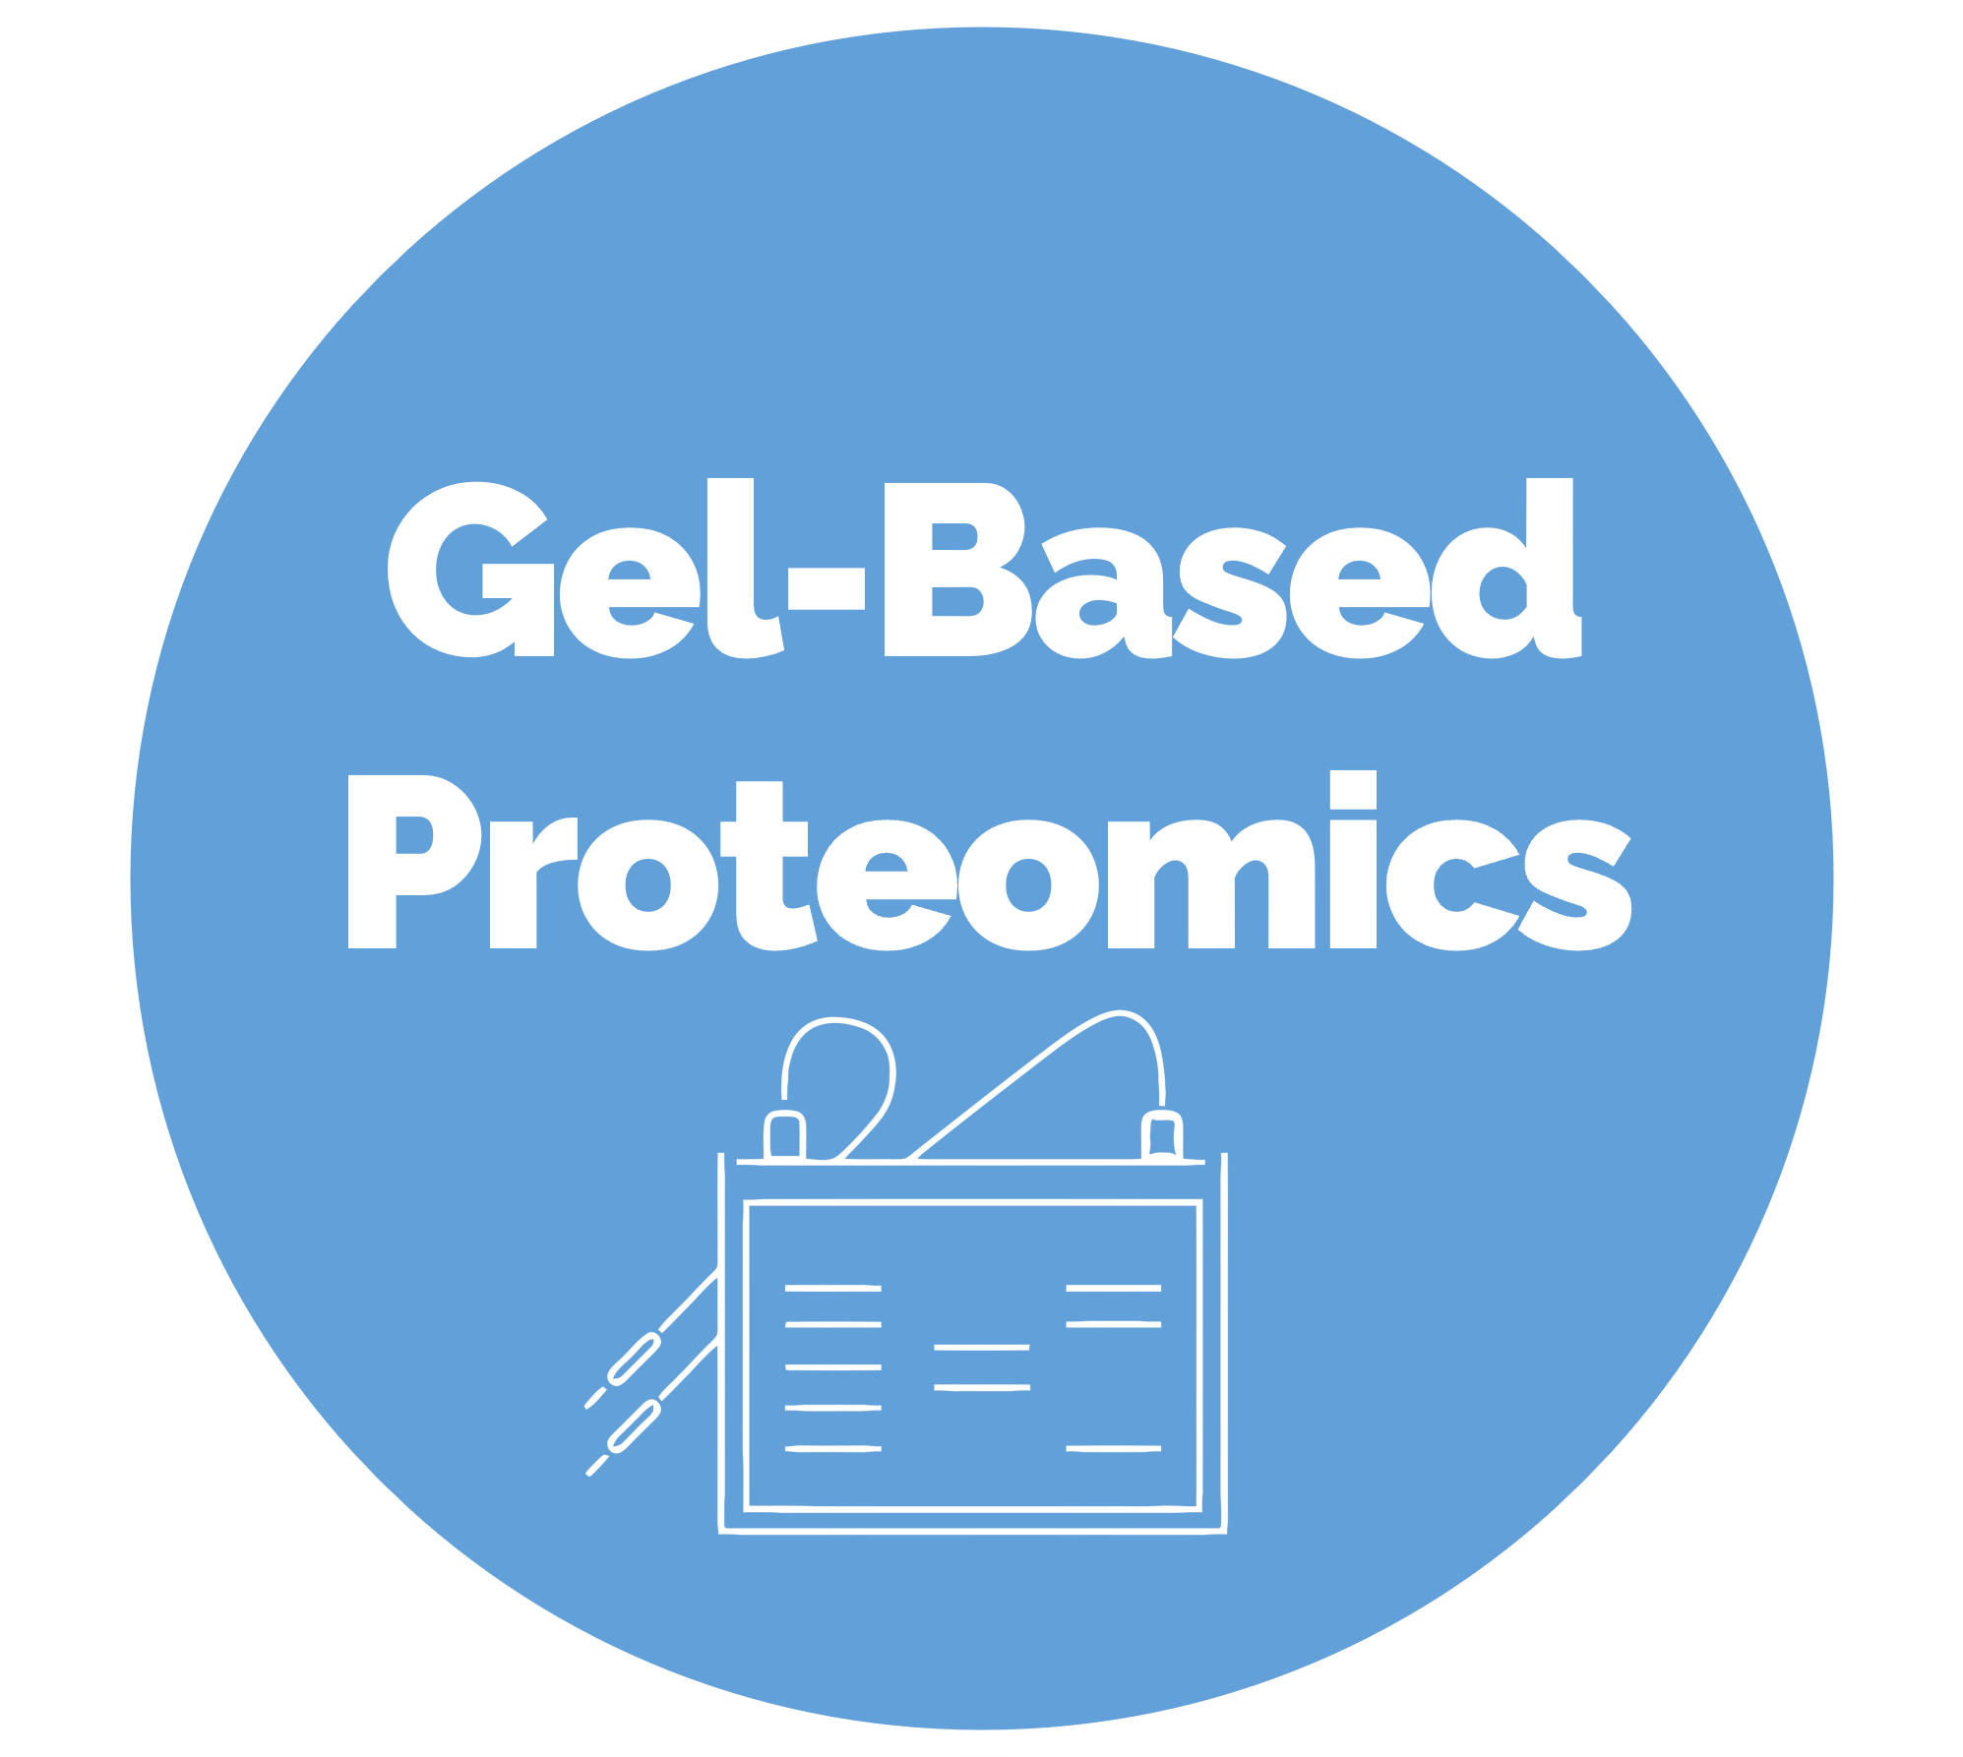

Notes:
In this recap, we will zoom in on the concept of Gel-Based Proteomics, try to understand what it is, why it matters, and how it works, and then provide time for a very brief questions and answers session. Please note that all my references are included in this presentation, and if anyone would like a copy of these slides, just ask. I’m more than happy to give them to you.

Slide 3




Gel-Based Proteomics
Notes:
So, Gel-Based Proteomics: What is it? Why do we care? And How does it work?

Slide 4

WHAT?
A Method of Global Protein
Separation^{[1]}
Quantification^{[1]}
Works on Principles of
Protein Electrophoresis^{[2]}
What is Gel-based proteomics?
Notes:
Although there are a couple of technologies within the domain of Gel-based proteomics, in the broadest sense, it is a method of protein separation and quantification, which works on the principles of protein electrophoresis. The reason why we can use the term “protein electrophoresis” is because all methods are essentially just variations on an Electrophoresis theme where we are concerned with the fractionation of proteins instead of nucleic acids.

Slide 5

We have a Problem
Need to Fractionate & Analyze the Whole Proteome
Over 100,000 proteins
In Different Cell Compartments
With Different Physical & Chemical Properties
Challenges in Extraction
Membrane proteins (hydrophobic)
Timing of protein extraction
Active versus inactive forms
Post-translational modifications
It is a Mature Solution
Popular ^{[1]}
Versatile^{[1]}
Cheaper than Gel-free Proteomics^{[1]}
WHY?
Why do we care about Gel-based proteomics?
Notes:
But why do we care? Well, as biomedical engineers we see a problem that demands a solution. Our ultimate problem is that we want to understand disease, so we can engineer a cure. As a sub-problem to better understanding disease, we need to Fractionate & Analyze the Whole Proteome, which is not an easy task. As Dr. Wu has mentioned, proteins are a lot more complex than DNA. There are move of them. They are compartmentalized. And they have different chemical and Physical properties.
That being said, Gel-based proteomics offers us a mature solution to the sub-task of better understanding disease. Currently, it’s popular, versatile, and cheaper than other methods. In fact, you can even find the equipment for it squirreled away in room N-181 of Engineering Building 1. In other words, Gel-based proteomics is a very accessible technology that can help us solve problems we care about, so it should matter to use how to use this technology

Slide 6

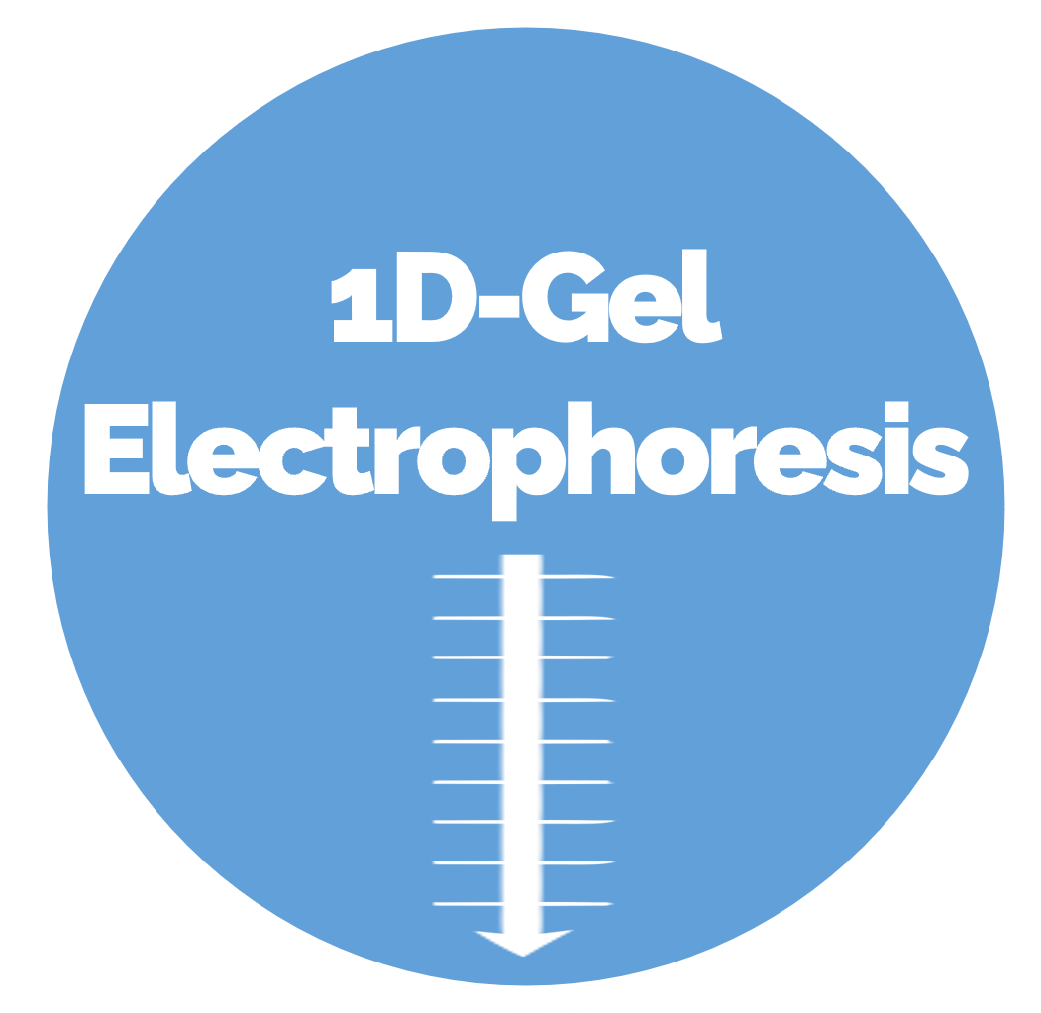
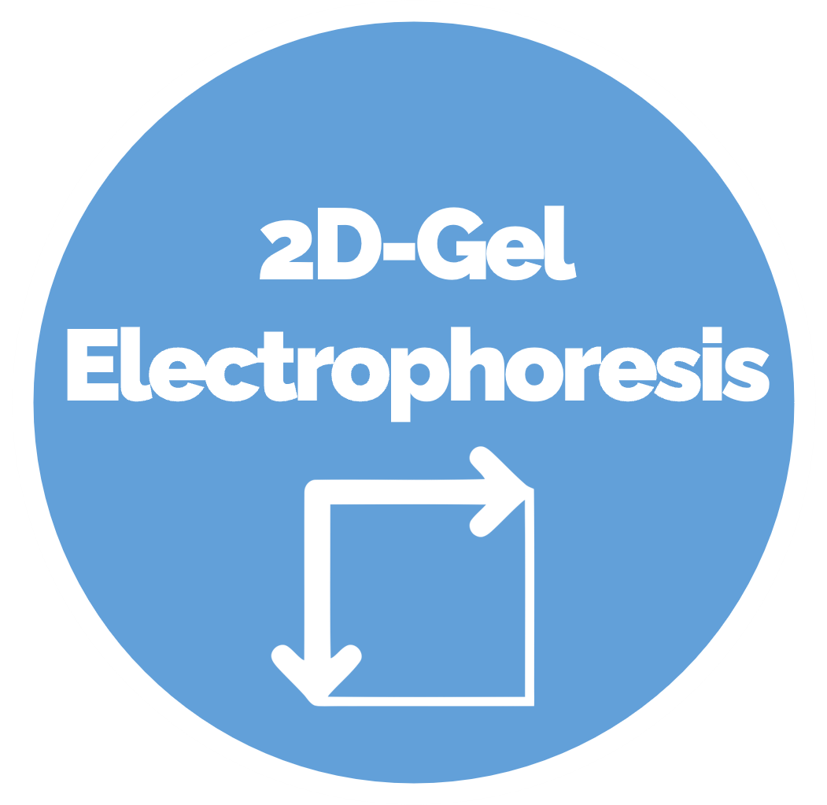
HOW?
How do Gel-Based Proteomics Work?
Notes:
That brings me to the most important aspect of this recap: How does do Gel-Based Proteomics Work? There are two techniques that we discussed last lecture, one-dimensional Gel Electrophoresis and two-dimensional Gel Electrophoresis.

Slide 7

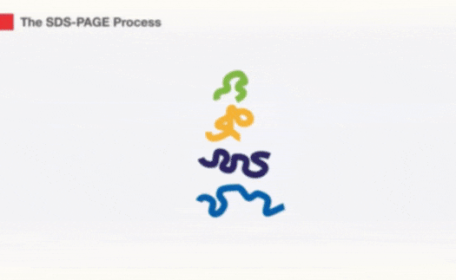


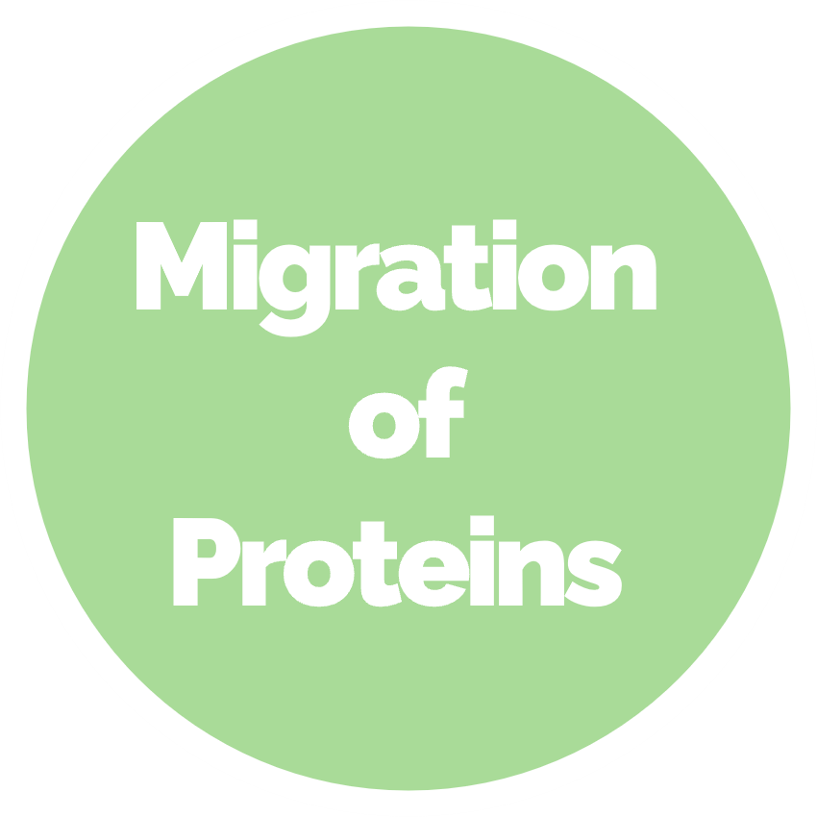


1D-Gel Electrophoresis
^{[ 3 ]}
Notes:
In one-dimensional Gel Electrophoresis, as so known as SDS-PAGE, SDS, the reducing agent, and heat are responsible for the denaturation of the protein sample, which is typically a cell lysate. Migration of the proteins occurs in the polyacrylamide gel during electrophoresis, which is called a PAGE system. This technique ultimately results in protein bands of specific molecular weight and does not separate all proteins from each other. Although proteins are not separated by charge, there are still a few important applications of one-dimensional gel electrophoresis.

Slide 8

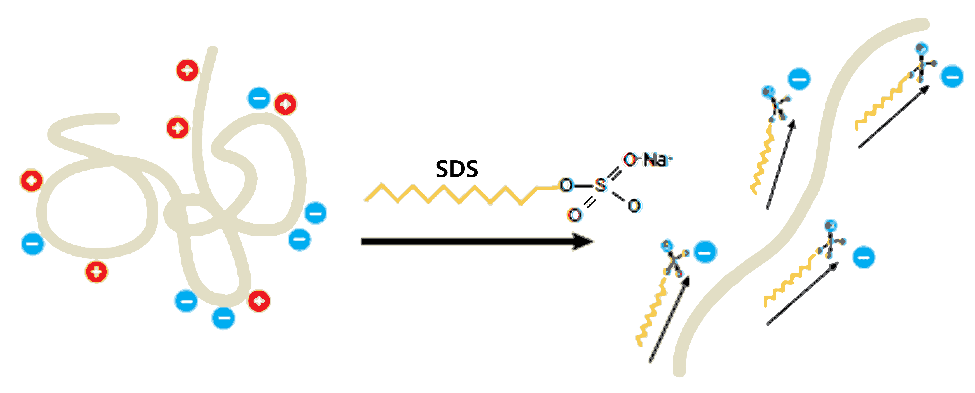
Denatures & Facilitates Migration
Adds negative charge to amino acids
Like Charges Repel
Breaks up the Secondary and Tertiary Structure
However
Some Quaternary Structure May Remain
Due to Disulfide Bonding (Covalent)
SDS :
Sodium Dodecyl Sulphate
Notes:
Looking closer at SDS, we can see what a crucial molecule it is in protein electrophoresis. Not only is it involved in denaturing the proteins, but it also helps the proteins move through the polyacrylamide gel. Essentially, SDS breaks up the two- and three-dimensional structure of the proteins by adding negative charge to the amino acids. Since like charges repel, the proteins are more-or-less straightened out, immediately rendering them functionless. Also, covering the proteins in negative charge causes them to move from the cathode to the anode in the PAGE system. However, SDS does not fully denature proteins, as some quaternary structures may remain due to disulfide bonding.

Slide 9

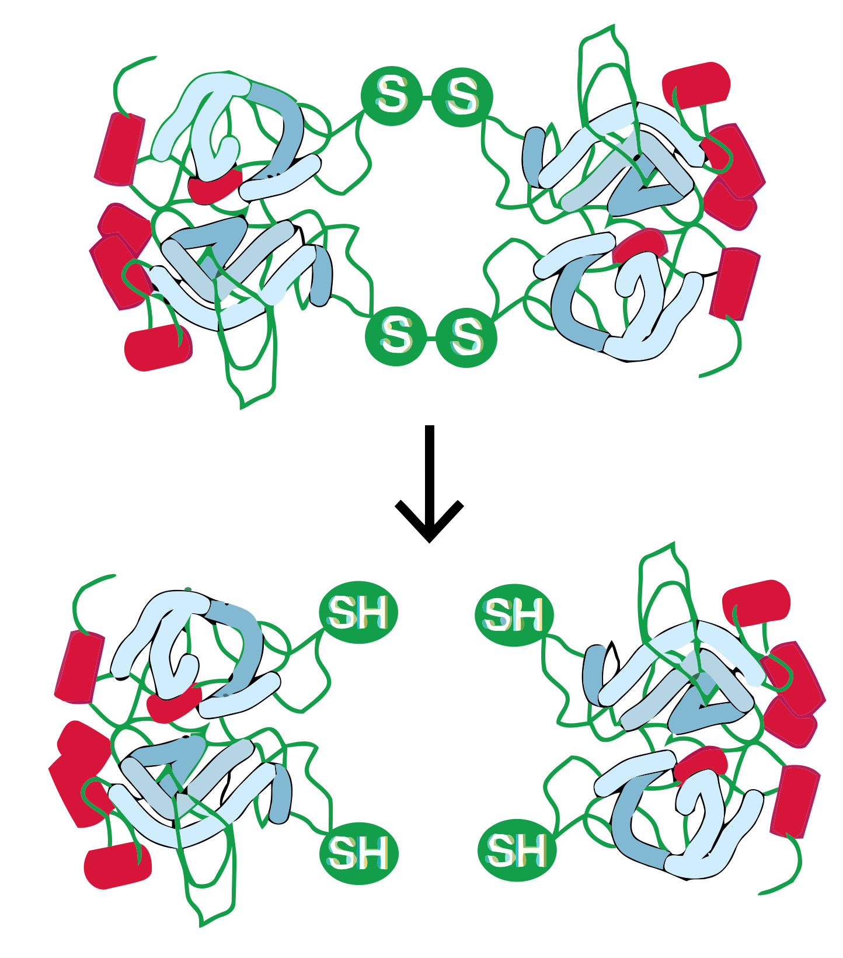

Problem: Disulfide Bonds
Cysteine has a sulfhydryl (-SH) group
Forms a Disulfide bond (-S-S-) with another sulfhydryl group
Not Disrupted by SDS
Solution: Thiol Reducing Agents
2-Mercaptoethanol (β-ME)
Dithiothreitol (DTT)
Reduces Disulfide Bonds
Reducing Agent
Notes:
Under normal intracellular conditions, the amino acid cysteine contains a sulfhydryl (-SH) group that spontaneously forms a disulfide bond (-S-S-) with another sulfhydryl group. Disulfide bonding is covalent and is not disrupted by SDS. β-ME and DTT are strong reducing agents. Their specific role in sample denaturation is to remove the last bit of tertiary and quaternary structure by reducing disulfide bonds, which is important for protein migration.

Slide 10
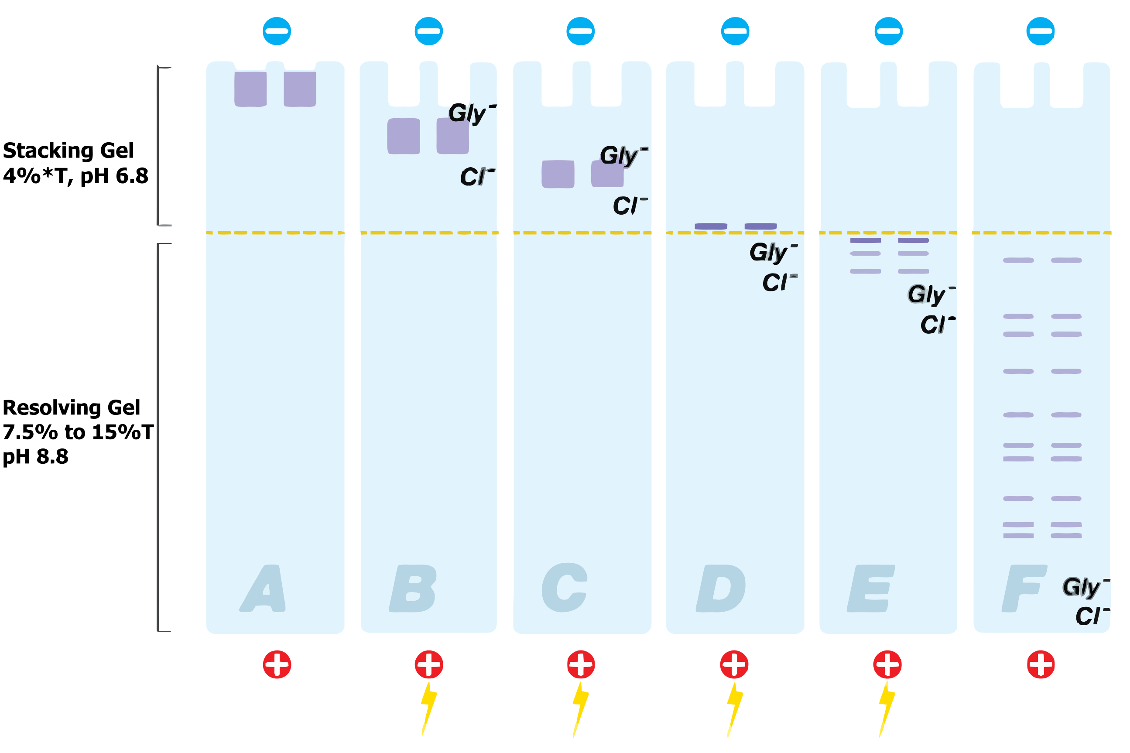

Migration of Proteins
Steps:
Denatured proteins loaded into wells
Voltage applied & proteins move into Stacking Gel
Voltage gradient created between the Cl⁻ and Gly⁻ ions
Proteins compress at interface of stacking & resolving gels
Acrylamide increases & Pore size decreases
Resolving gel separates proteins by molecular weight
Charge-to-mass ratio is equal due to SDS
Proteins are separated into bands by molecular weights
Notes:
The Migration of Proteins refers to the PAGE process. After the proteins have been reduced to their primary structures and covered in negatively charged SDS, they are loaded into wells and then a voltage is applied. As proteins move into the stacking gel, a voltage gradient is created between chloride and glycinate ions. Once the proteins get to the interface between stacking & resolving gels, they are compressed due to the increasing acrylamide and decreasing pore size. Since the SDS has equalized their charge-to-mass ratio, once proteins are in the resolving gel they are separated by molecular weight. At the end, one sees the proteins as separate bands that correspond to their molecular weight.

Slide 11
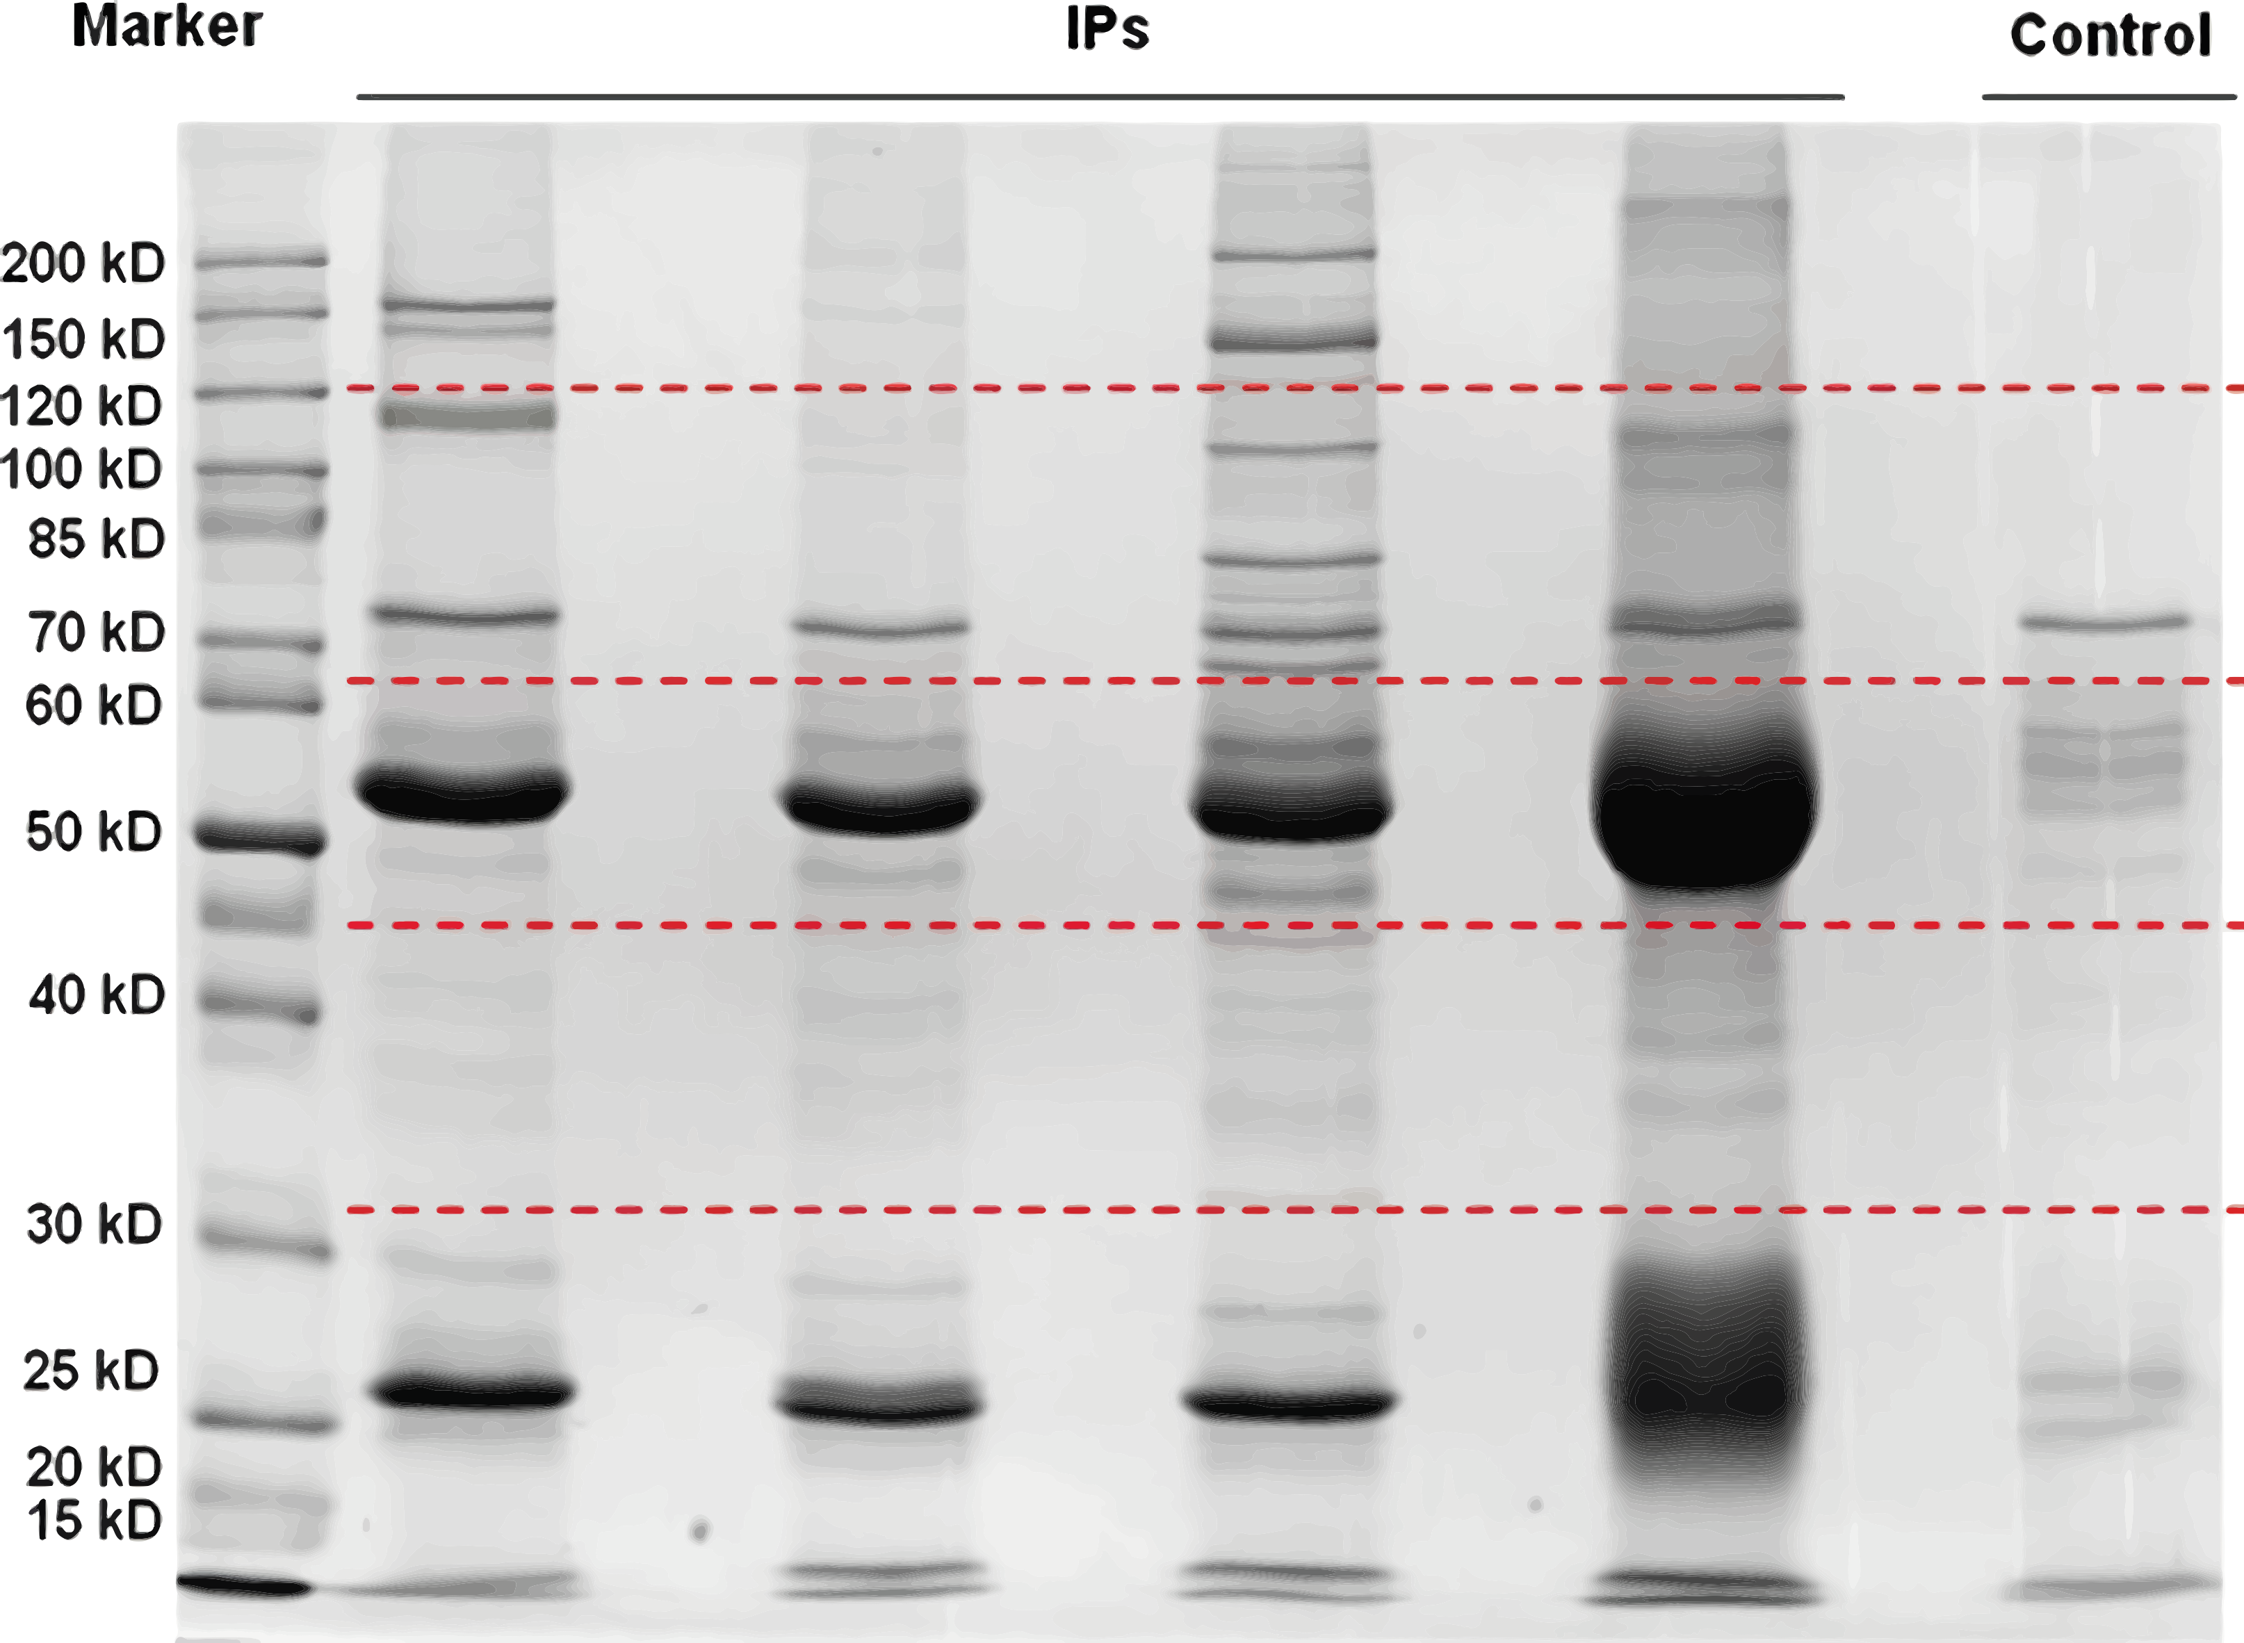
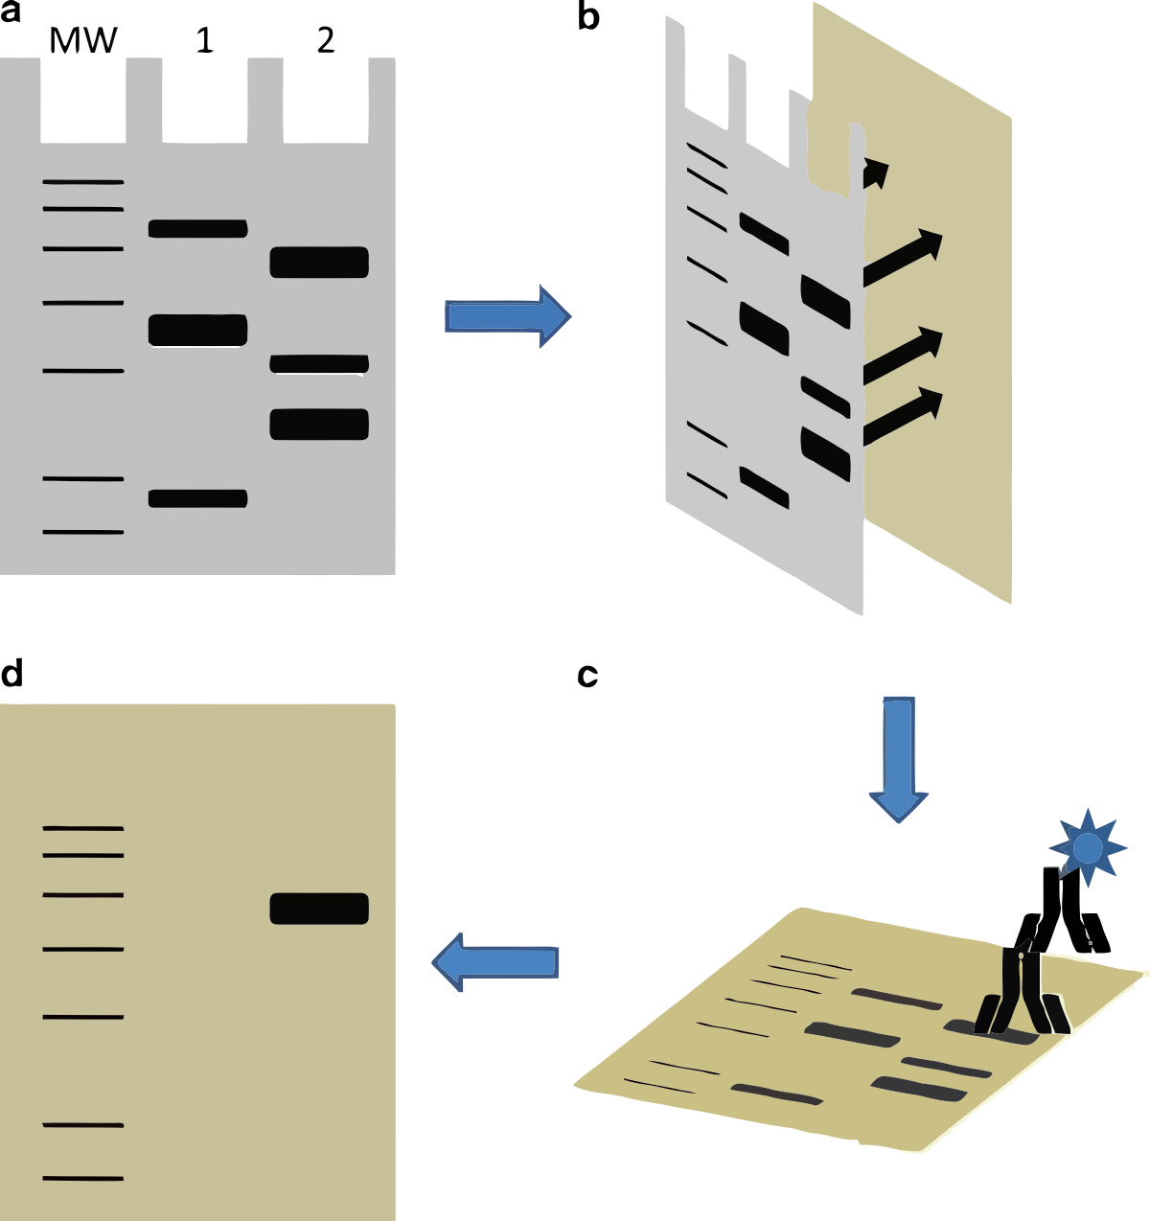

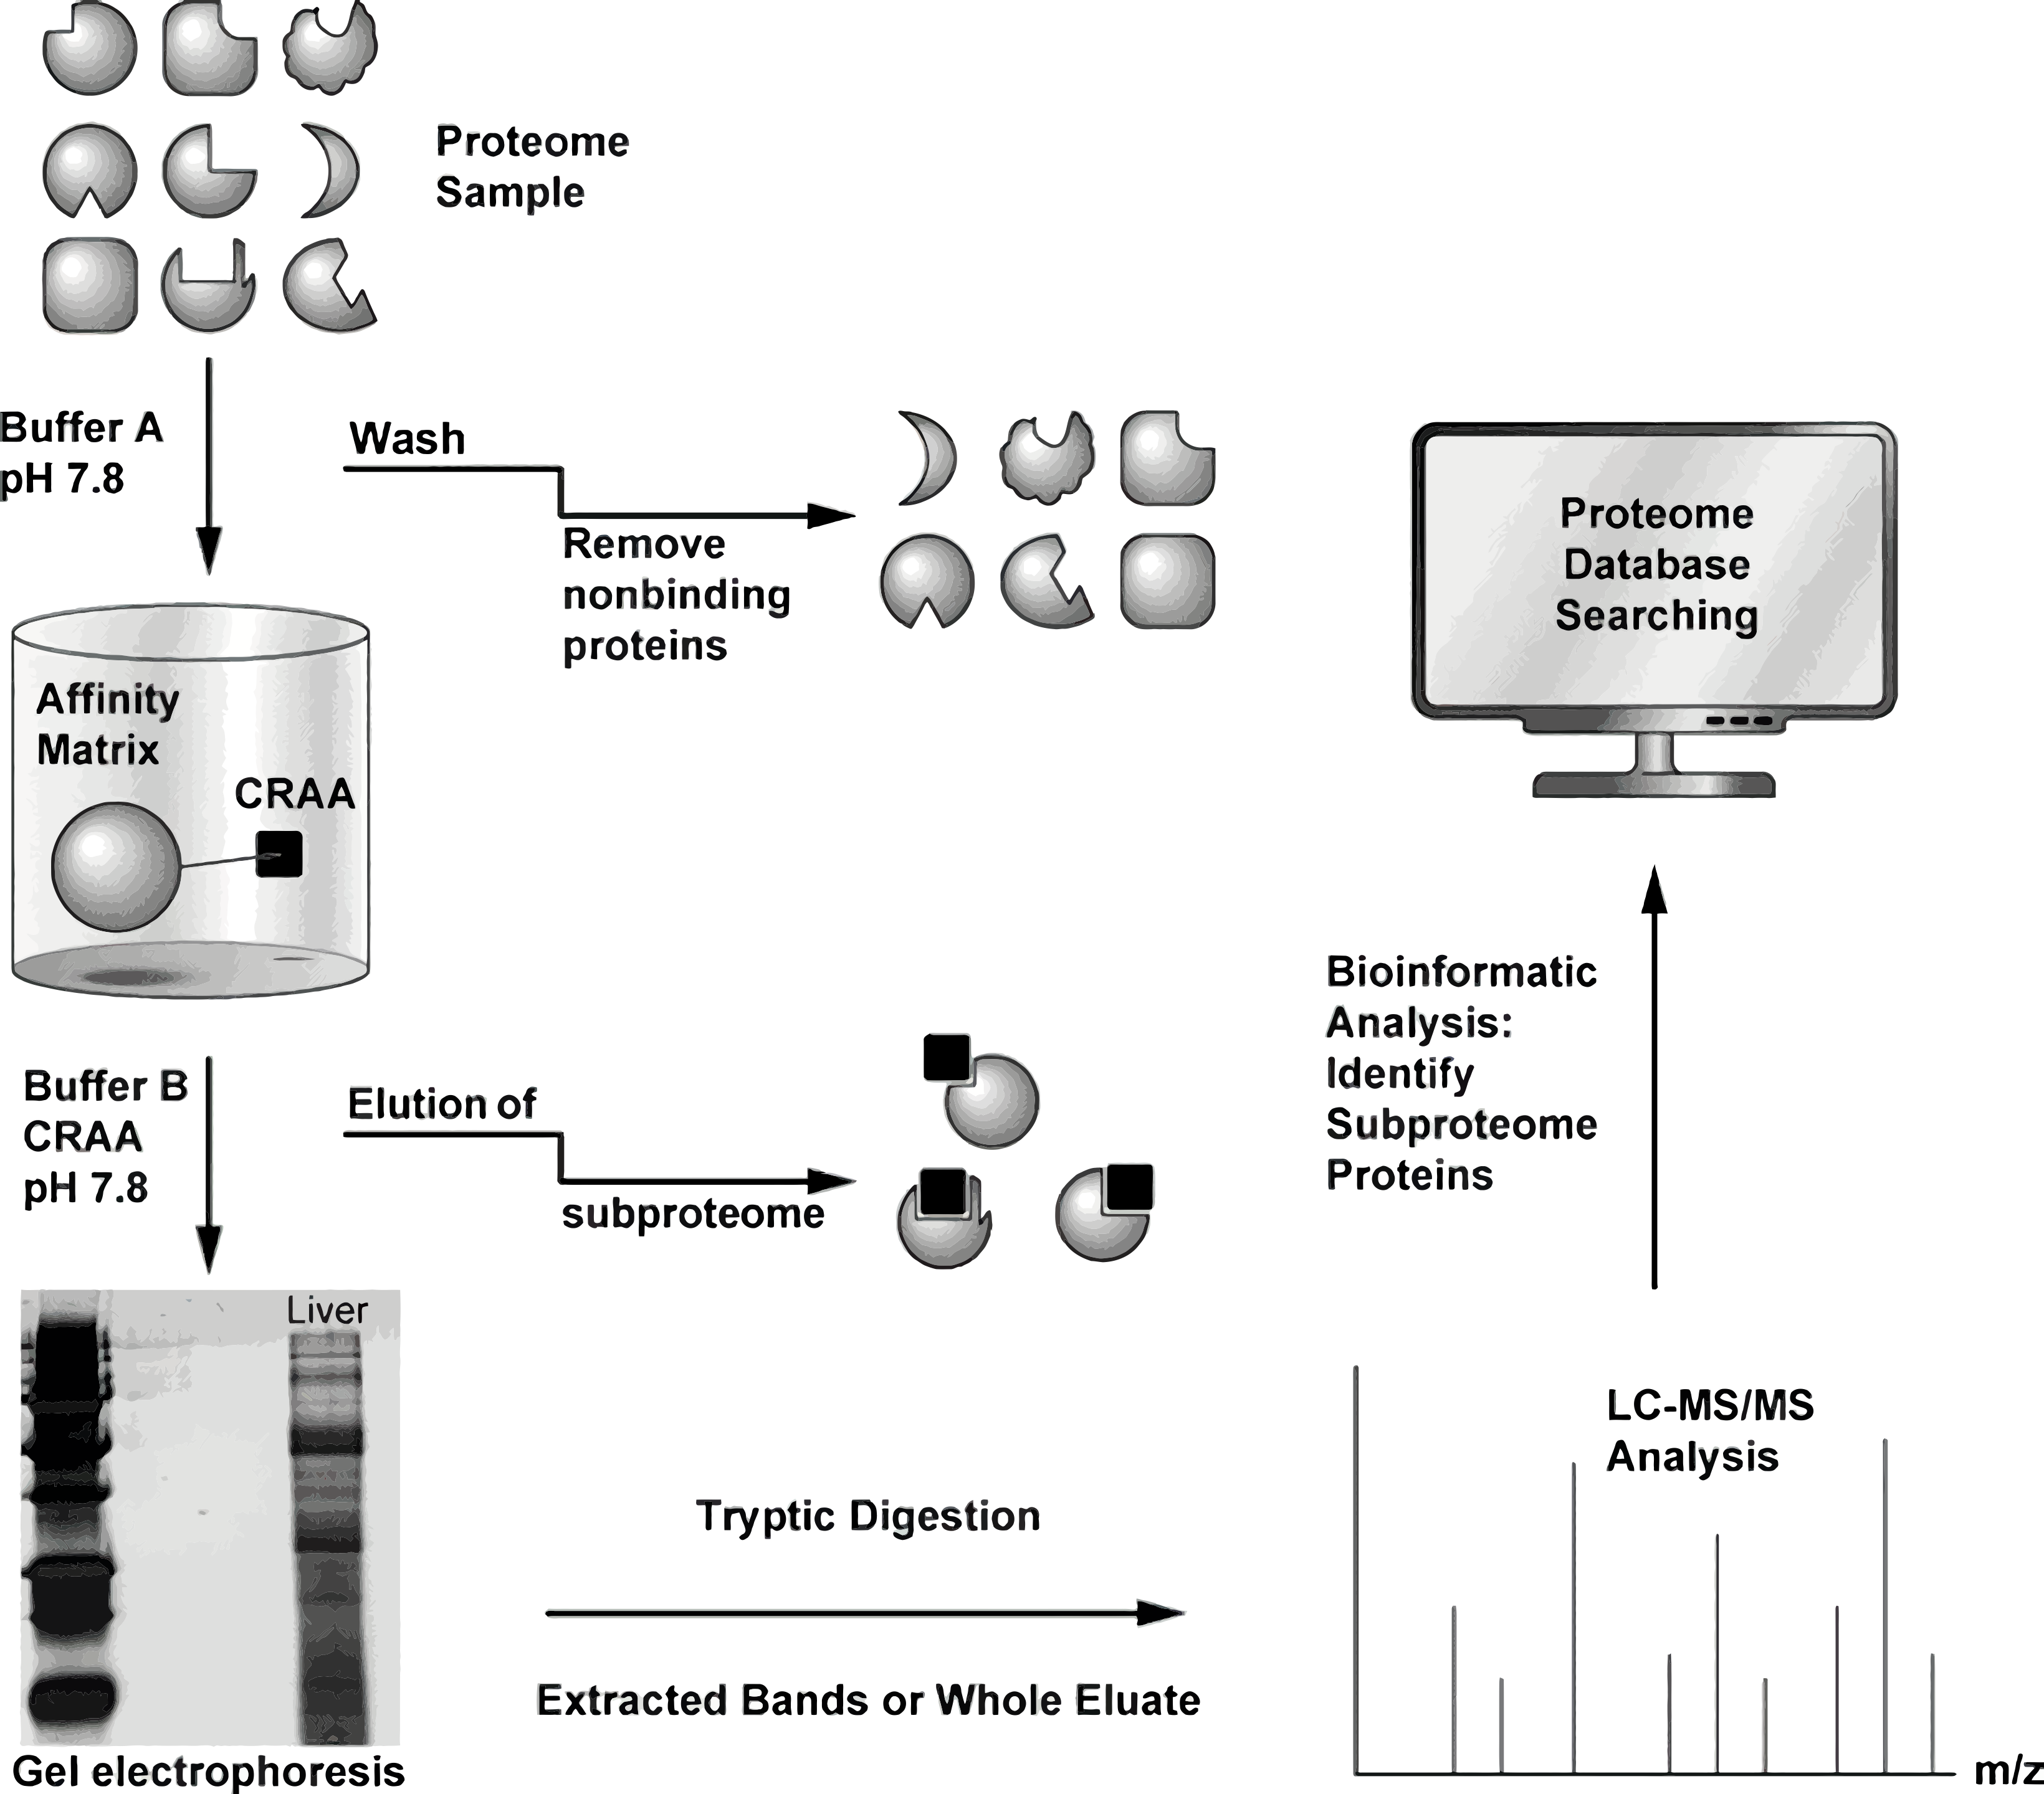
Immunoprecipitation Followed by 1D PAGE
SDS-PAGE Immunoblot
1D-Gel Electrophoresis
Applications
1D Gel Electrophoresis Followed by Protein Identification
Notes:
Although one-dimensional gel electrophoresis does not completely separate protein, it does have applications. The most well known is arguably SDS-PAGE Immunoblot, which is also known as Western Blotting. The goal is to use an antibody to identify a particular antigen within a complex mixture of proteins. One can therefore use 1D gel electrophoresis to determine a number of important characteristics of protein antigens, such as the presence and quantity of an antigen, the relative molecular weight of the polypeptide chain, and the efficiency of extraction of the antigen.

Slide 12
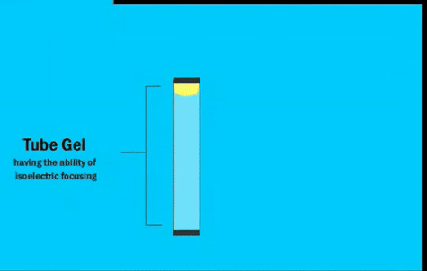



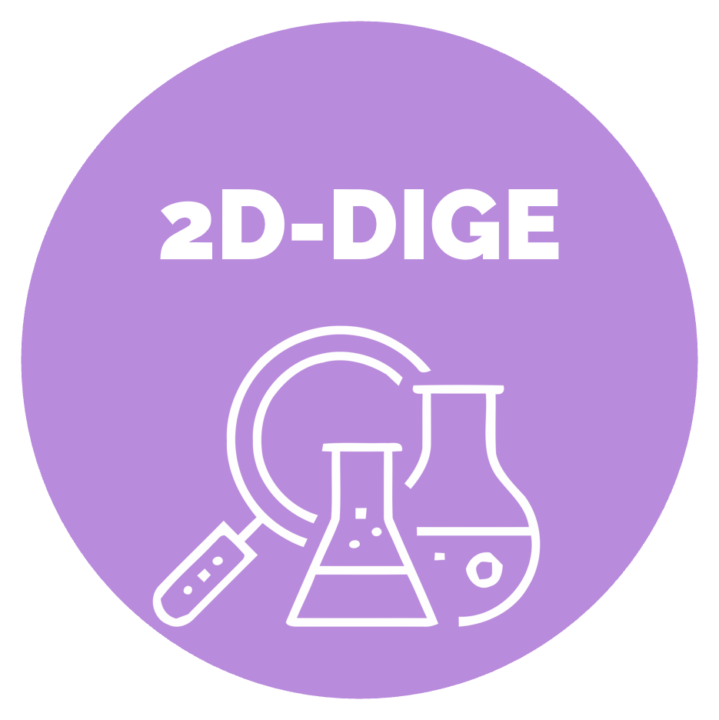
2D-Gel Electrophoresis
SDS-PAGE
^{[ 4 ]}
Notes:
One dimensional Gel Electrophoresis is basically a subset of two-dimensional Gel Electrophoresis. In two-dimensional Gel Electrophoresis, we are doing Gel Electrophoresis on top of Gel Electrophoresis. We begin with Isoelectric Focusing, also know as IEF, and we end with SDS-PAGE. Typically, but not always, a tube gel with ampholyte molecules is used for IEF to separate proteins by charge. Once separated by their charge, we do the same process described in one-dimensional Gel Electrophoresis . Since IEF is what differentiates these technologies, lets zoom in on that concept.

Slide 13
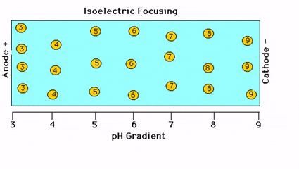

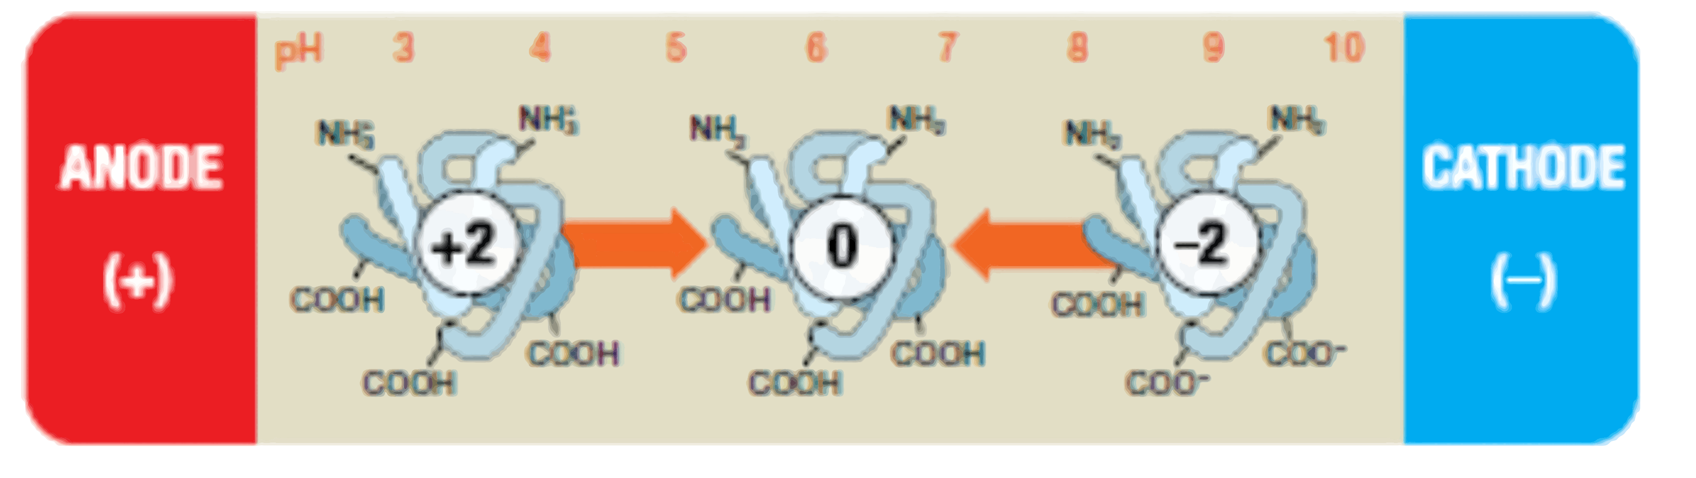
IEF Process
pH gradient by ampholyte molecules in an electric field
Gradient increases from acidic (pH 3) at the anode to basic (pH ~ 9 to 10) at the cathode
Positively Charged Proteins move toward cathode (-)
loses protons, becomes less positively charged
Negatively charged Proteins move toward anode (+)
Gains protons, becomes more positively charged
Protein cease to move at pI.
pI is the isoelectric point
pI is the pH of a solution where net charge of a protein is zero.
Process sorts proteins by charge
IEF:
Isoelectric Focusing
^{[ 5 ]}
Notes:
The first dimension of two-dimensional Gel Electrophoresis is isoelectric focusing. This process separates proteins based on isoelectric point, which is the pH of a solution where net charge of a protein is zero. IEF works through ampholyte molecules creating a stable pH gradient in the gel and the application of an electric field. Something worth mentioning is that ampholytes are molecules that contain both acidic and basic groups, and they can either donate or accept a proton. So, as Positively Charged Proteins move toward the cathode, they lose protons and become less positively charged. Likewise, as negatively charged Proteins move toward the anode, they gains protons and become more positively charged. This occurs until the net charge of the respective proteins is zero, or in other words it occurs until the proteins hit their isoelectric point. In this way, proteins are sorted by their charge.

Slide 14

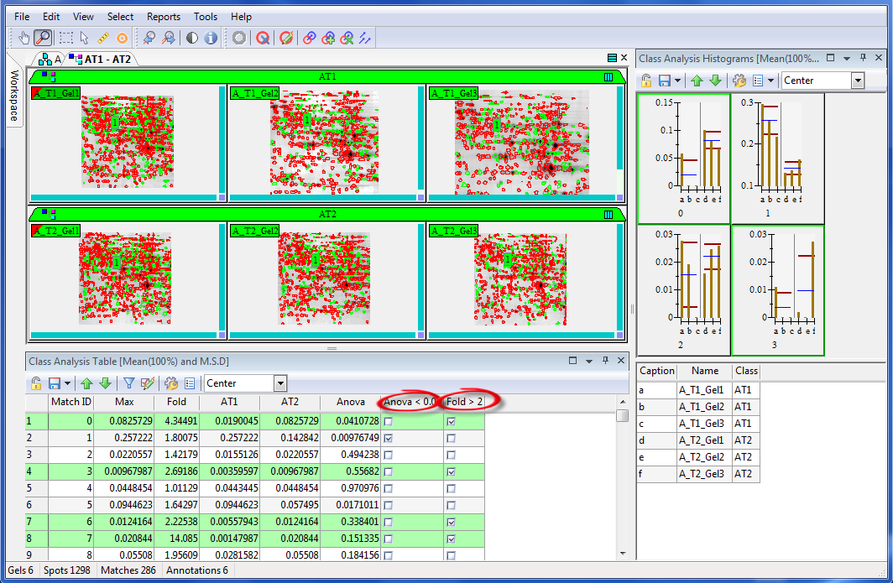
2-D gel protein profiles are reproducible
Cannot interpret with eyes
Requires software to
Detect Spots
Overlay and register all gels in a group to a reference
Match spots on all the gels in the group
Create a single composite image of all the gels
Use statistical analysis to interpret the data
Image Analysis & Interpretation
Notes:
Although two-dimensional gel electrophoresis is good at fractionating proteins in a reproducible fashion, one cannot typically use their eyes to analyze and interpret the data. We need to perform image analysis using sophisticated software that detects spots. Once spots are detected, the program then needs to overlay and registers all gels in a group to match one specified reference gel from that group. After that, it must match spots on all the gels in the group, and then create a single composite image of all the gels. Only after this type of image analysis, can one use statistical analysis to interpret the data.

Slide 15
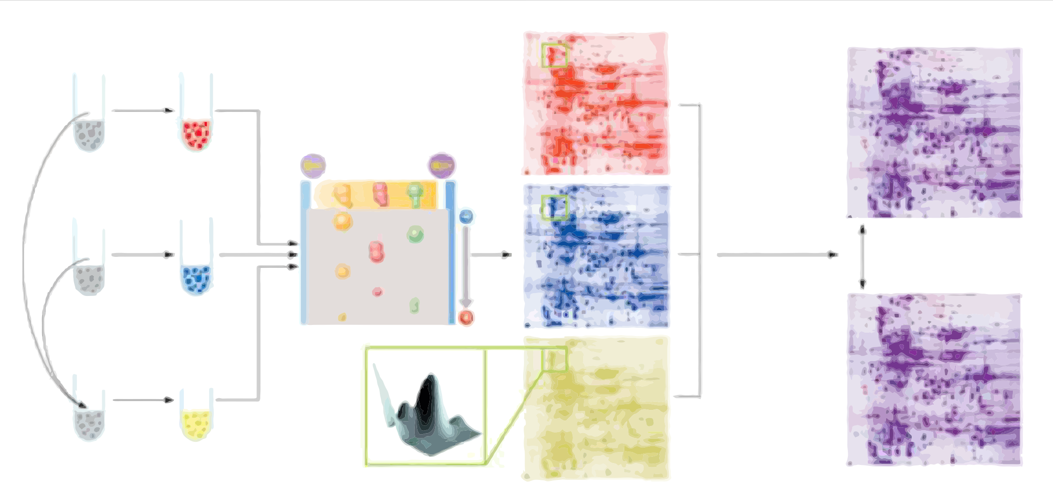
Advanced 2D-Gel Electrophoresis
More confidence
Reflects true biological outcomes
Less gels & Saves time
Reduces the large number of replicates that are used in the conventional, single stain 2D gel method
Higher accuracy
Less false negative & false positive
Quantitative data
Proteins are pre-labelled with Fluorescent CyDyes
Cy2 dye is used to label an internal standard
a pooled sample
Allows both inter and intra gel matching
Standardizes spot volumes in different gels
Spot volumes are a ratio of the internal standard
Functional Specific Protein Stains Exist
Allows a Multiplexed Proteomics approach
Pro-Q Diamond – phosphorylation
Pro-Q-Emerald – glycosylation
SYPRO-Ruby – total proteins
Images acquired with lasers & analyzed with differential image analysis software
Difference Gel Electrophoresis (DIGE)
Notes:
The final concept worth reviewing is Difference Gel Electrophoresis. In essence, it’s a more advanced form of 2D-Gel Electrophoresis that uses Fluorescent Dyes to save time and resources, give higher accuracy, provide quantitative data, and better reflect true biological outcomes. The key to this workflow is pre-labelling proteins with fluorescent dyes. However, aside from just labeling the proteins dyes, a pooled sample stained with Cy2 must be used as an internal standard. With this standard as a reference, we can do inter and intra gel matching, as well as standardize spots and express them as a ratio to the internal standard. Finally, images are acquired with lasers and & analyzed with differential image analysis software.
One can also use functional Specific Protein Stains to take a Multiplexed Proteomics approach. Hopefully, my associate Alejandro will have more to say about this and Difference Gel Electrophoresis. Thank you all for your time!!

Slide 16


Questions & Answers

Slide 17
References
[1] F. Chevalier, "Highlights on the capacities of "Gel-based" proteomics", Proteome Science, vol. 8, no. 1, p. 23, 2010. Available: 10.1186/1477-5956-8-23 [Accessed 27 October 2021].
[2] T. Rabilloud, "Variations on a theme: Changes to electrophoretic separations that can make a difference", Journal of Proteomics, vol. 73, no. 8, pp. 1562-1572, 2010. Available: 10.1016/j.jprot.2010.04.001 [Accessed 27 October 2021].
[3] Thermo Fisher Scientific, "Overview of Electrophoresis", Thermofisher.com, 2021. [Online]. Available: https://www.thermofisher.com/us/en/home/life-science/protein-biology/protein-biology-learning-center/protein-biology-resource-library/pierce-protein-methods/overview-electrophoresis.html. [Accessed: 28- Oct- 2021].
[4] BioTech Online, "Explanation of Proteomics 2D Gel Electrophoresis", DnaTube.com - Scientific Video and Animation Site, 2021. [Online]. Available: https://www.dnatube.com/video/27901/Explanation-of-Proteomics-2D-Gel-Electrophoresis. [Accessed: 28- Oct- 2021].
[5] M. Padula, "Isoelectric focusing of proteins", Youtube.com, 2021. [Online]. Available: https://www.youtube.com/watch?v=ebrAlKLvw0M. [Accessed: 28- Oct- 2021].

